Slide 1
Overview of ADO.NET
What is Ado. Net
ADO.NET is a object model or database technology of the .NET Framework, and it buits on Microsoft ActiveX Data Objects (ADO).
It is an integral part of the .NET Framework, providing access to relational data[ SqlServer, MySql, Oracle, Msaccess], XML documents, and application data
Provides data access services using Microsoft .NET platform
Ado.net come up with set of object-oriented libraries that allows you to interact with diff data sources.
Commonly, the data source is a data base, but it could also be a text file, an Excel spread sheet, or an XML file
ADO.NET serializes data using XML. i.e. Reading and Writing data from datasource in the form of XML format.
Ado.net is Integrated with XML.

Slide 2
Data Providers
ADO.NET allows us to interact with different types of data sources and different types of databases
Since different data sources expose different protocols, we need a way to communicate with the right data source using the right protocol
ADO.NET provides a relatively common way to interact with data sources, but comes in different sets of libraries for each way you can communicate to a data source
These libraries are called Data Providers.
Simply Data providers are libraries to communicate with diff data sources.

Slide 3
Data Provider
Provider Name | Base Library | Data source description
ODBC Data Provider | System.Data.ODBC | Data Sources with an ODBC interface. Normally older data bases
OleDb Data Provider | System.Data.OleDb | Data Sources that expose an OleDb interface, i.e. Access or Excel
Oracle Data Provider | System.Data.Oracle | For Oracle Databases
SQL Data Provider | System.Data.SqlClient | For interacting with Microsoft SQL Server

Slide 4
Data Provider
SQL data provider
OLE DB
Data provider
Oracle provider
ODBC .
Data provider
SQL SERVER
Ms Access & excel
ORACLE
ODBC DATA

Slide 5
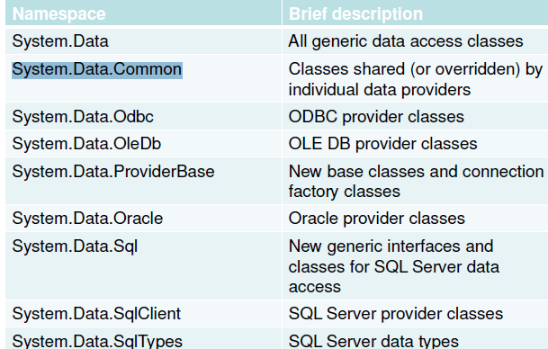
ADO.NET Namespaces

Slide 6
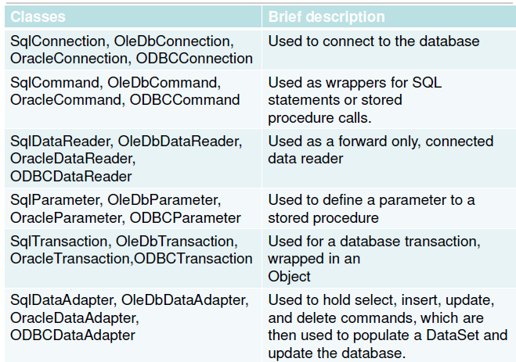
ADO.NET Classes

Slide 7
ADO.NET
Classes under System.Data.Sqlclient
SqlConnection
SqlCommand
SqlDatareader
SqlDataadaptor
SqlParameter
SqlTransaction

Slide 8
Connection
To interact with a database, you must have a connection to it.
The connection helps identify the database server, the database name, user name, password, and other parameters that are required for connecting to the data base
The connection tells the rest of the ADO.NET code which database it is talking to
For Ex: A connection object is used by command objects so they will know which database to execute the command on
Connection is a very valuable resource and it has to be used carefully, especially in large enterprise applications.
Connections that are left open, can have serious impact on performance

Slide 9
SqlConnection
A SqlConnection is an object, just like any other C# object
The purpose of creating a SqlConnection object is so you can enable other ADO.NET code to work with a database
Other ADO.NET objects, such as a SqlCommand and a SqlDataAdapter take a connection object as a parameter
SqlConnection object needs certain information to establish a connection
This is assigned to the connection object with the help of a Connection String
Sqlconnection con=new SqlConnection("Connection string");
ADO.NET Connection Strings contain certain key/value pairs for specifying how to make a database connection.
They include the location, name of the database, and security credentials[Username,Password]

Slide 10
SqlConnection
Connection String parameters:
Parameter Name | Description
Data Source | Identifies the Location server. Could be local machine, machine domain name, or IP Address
User ID | Name of user configured in SQL Server
Password | Password matching SQL Server User ID
Initial Catalog | Database name
Integrated Security | Set to SSPI to make connection with user's Windows login
SqlConnection con = new
SqlConnection("Data Source=local; Initial Catalog=SalesOrder; User ID=sa; Password=sqltest");

Slide 11
SqlConnection
methods:
open()-to open a connection
close()-to close the connection
dispose()-to destroy the instance
Begin Transaction()
Properties:
State:-it state the connection is open or not
Connectionstring:- Get and Set the Connection string
Server version:-returns version of a server
DataSource:-Return data source name
Database:-Return data base name

Slide 12
SqlConnection
Points to Remember:
Once connection object is instantiated, we need to open the connection
This is done with the help of Open method
After the connection is open we can perform the tasks that need to be done
Once task is completed, we need to close the connection by calling the Close method
Failure to close connections could have serious consequences in the performance and scalability of your application
Close method can be implemented in the finally block to ensure it is called

Slide 13
SqlCommand
Command class used to Execute Sql statements against the database.
Sql Statement could be any one of following type.
DDL-create, alter, drop
DML-insert, update, delete
TCL-commit, rollback
QL-select
Command class could also be used to invoke the stored procedure and functions from the database.
Initialization:
SqlCommand cmd = new SqlCommand(“Sql_Statement”, con);

Slide 14
SqlCommand
string Source = “Data Source=local; Integrated security=SSPI; Initial Catalog=SalesOrder”;
string Select = “SELECT CustomerId, CustName FROM Customers”;
SqlConnection Conn = new SqlConnection(source);
Conn.Open();
SqlCommand Cmd = new SqlCommand(Select, Conn);

Slide 15
Sql Command
Once a command is defined, we need to execute the command
Different ways exist to issue the statement, depending on whatyou expect to be returned (if anything) from that command
Command classes provide the following execute methods
ExecuteNonQuery() — Executes the command but does not return any Output
ExecuteReader() — Executes the command and returns a typed IDataReader
ExecuteScalar() — Executes the command and returns a single value
ExecuteXmlReader() — Executes the command and returns an XmlReader

Slide 16
Sql Command
int ExecuteNonQuery():
This method is commonly used for INSERT, UPDATE, DELETE Statements
it returns how many records are executed against database
string source = “Data Source=local; Integrated Security=SSPI; Initial Catalog=SalesDB”;
string select = “UPDATE Customers SET CustomerName = ‘KK’ WHERE CustomerId = 776”;
SqlConnection conn = new SqlConnection(source);
conn.Open();
SqlCommand cmd = new SqlCommand(select, conn);
int rowsReturned = cmd.ExecuteNonQuery();
conn.Close();

Slide 17
Sql Command
ExecuteScalar()
On many occasions, it is necessary to return a single result from a SQL statement, such as the count of records in a given table, or the current date/time on the server
Returns the first value from the select statement. Return type is object, hence we need to cast based on the data type of the value
string source = “Data Source=local; Integrated Security=SSPI; Initial Catalog=SalesDB”;
string select = “SELECT COUNT(*) FROM Products”;
SqlConnection conn = new SqlConnection(source);
conn.Open();
SqlCommand cmd = new SqlCommand(select, conn);
int Count = (int) cmd.ExecuteScalar();
Console.WriteLine(“Total No of Products : {0}”, Count);
conn.Close();

Slide 18
Sql Command
ExecuteReader()
This method executes the command and returns a typed data reader object, depending on the provider in use.
The object returned can be used to iterate through the record(s) returned
string source = “Data Source=local; Integrated Security=SSPI; Initial Catalog=SalesDB”;
string select=“SELECT CustomerId,CustomerName FROM Customers”;
SqlConnection conn = new SqlConnection(source);
conn.Open();
SqlCommand cmd = new SqlCommand(select, conn);
SqlDataReader reader = cmd.ExecuteReader();
conn.Close();

Slide 19
Sql Command
ExecuteXmlReader() (SqlClient Provider Only)
This method executes the command and returns an XmlReader object to the caller
string source = “Data Source=local; Integrated Security=SSPI; Initial
Catalog=SalesDB”;
string select=“SELECT CustomerId,CustomerName FROM Customers
FOR XML AUTO”;
SqlConnection conn = new SqlConnection(source);
conn.Open();
SqlCommand cmd = new SqlCommand(select, conn);
XmlReader xr = cmd.ExecuteXmlReader();
xr.Read();

Slide 20
Sql Command
Properties:
string CommandText:
Get and Set sql statement to command object.
cmd.commandtext="Sql_statement"
SqlConnection Connection:
Get and Set connection object to the command object.
cmd. Connection=con
Commandtype,parameters-These are required for working with stored procedures.

Slide 21
Sql DataReader
A data reader is the simplest and fastest way of selecting some data from a data source
It can only read data and cannot write
You cannot directly instantiate a data reader object An instance is returned from the appropriate database ’ s command object (such as SqlCommand ) after having called the ExecuteReader() method
DataReaders are often described as fast-forward firehose-like streams of data

Slide 22
Sql DataReader
Once you've read some data, you must save it because you will not be able to go back and read it again
The forward only design of the DataReader is what enables it to be fast
Therefore, if your only requirement for a group of data is for reading one time and you want the fastest method possible, the DataReader is the best choice
The typical method of reading from the data stream returned by the SqlDataReader is to iterate through each row with a while loop

Slide 23
Sql DataReader
The database connection used is kept open until the data reader
has been closed
The DataReader class has an indexer that permits access to any field using the familiar array style syntax
object o = aReader[0]; or object o = aReader[“CustomerID”];
Accessing through indexer is going to be faster however the latter is more readable
Regardless of the type of the indexer parameter, a DataReader
indexer will return type object
We can convert to anything after that and proceed with our
requirement
Reader has to be closed at the end

Slide 24
Sql DataReader
The database connection used is kept open until the data reader has been closed
string source = “Data Source=local; Integrated Security=SSPI; Initial Catalog=SalesDB”;
string select=“SELECT CustomerId,CustomerName FROM Customers”;
SqlConnection conn = new SqlConnection(source);
conn.Open();
SqlCommand cmd = new SqlCommand(select, conn);
SqlDataReader reader = cmd.ExecuteReader();
while(reader.Read())
{
Console.WriteLine(“ID : {0} Name : {1}”, reader[0] , reader[1]); or
Console.WriteLine(“ID : {0} Name : {1}”, reader[“CustomerId”] ,
reader[“CustomerName”]);
}
reader.Close();
conn.Close();

Slide 25
Sql DataReader
Methods:
Read(): It Reads the records in dr object one by one in forward only direction.
if record exist on dr object it returns true or else returns false
dr[index]-it reruns the value of specific index column
dr[column-name]- it reruns the value of specific index column
Note: dr object returns value in the form object.
close() :it will close the DataReader object.
Properties:
bool HasRows:-it returns true if dr is having records or returns false
int FieldCount:- it returns no of columns.
bool IsClosed:-it checks whether the dr object is closed or not, returns true if data Reader is closed or else returns false.

Slide 26
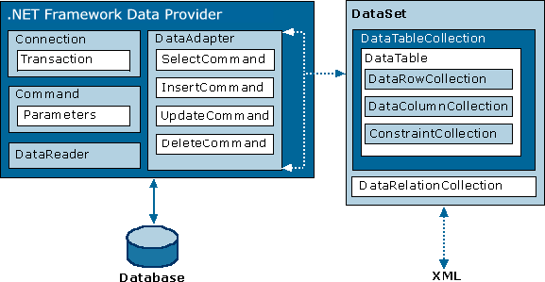
The Ado.net Object Model.

